Slide 1
ZFS Raiders of the Lost File
Nikolaos Tsapakis, LEHACK 2023

Slide 2
Intro
a hot summer day back in 2019
an old hard drive
a file that I forgot to backup
a format process that got interrupted in panic
a poem that was brought back to life
this is a forensics story

Slide 3
The Hard Disk
FreeBSD image with ZFS filesystem
LZ4 compression on
compresses files on the fly
tried many free recovery tools but in vain
recover the file by directly accessing the disk ?

Slide 4
Creating Hard Disk Image
ddrescue /dev/ada0 /media/ada0.backup
25 gb of size
can now start working on the image

Slide 5
The File
I remember it was an .rtf file
possibly < 64 kb in size
ZFS may allocate multiple data blocks for bigger files
notice smallest data block as a file grows is close to 65 kb
65 kb of compressed space for storing continuous file data
only a single block for our file if we are lucky

Slide 6
The Signature
compress an .rtf sample file using LZ4
check header after compression
create signature based on compressed header
run signature against image
verify that signature triggers on .rtf files

Slide 7
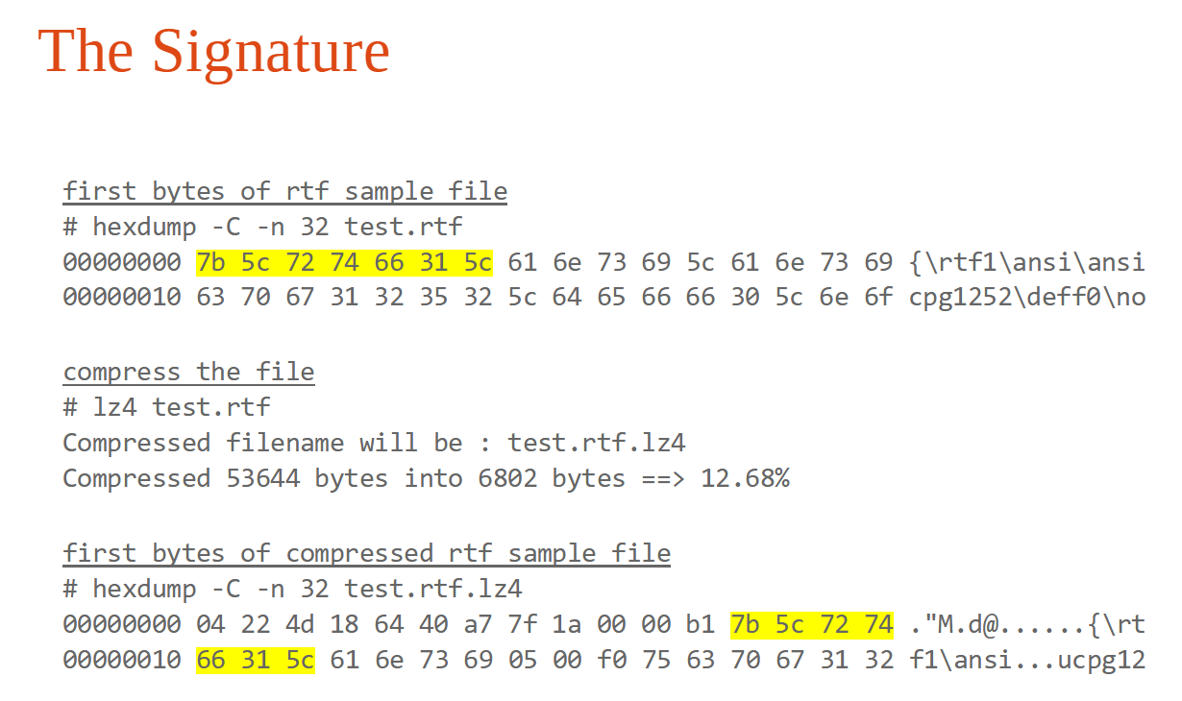

Slide 8
The Signature
rule detect_rtf
{
strings:
$rtf_header = { 7B 5C 72 74 66 31 5C }
condition:
$rtf_header
}

Slide 9
The Hunt
yara64.exe -s detect_rtf.yara ada0.backup
Results
0x1456b6005:$rtf_header: 7B 5C 72 74 66 31 5C
0x1666b1005:$rtf_header: 7B 5C 72 74 66 31 5C
0x1666c3005:$rtf_header: 7B 5C 72 74 66 31 5C
0x18991a28e:$rtf_header: 7B 5C 72 74 66 31 5C
0x2c20348fa:$rtf_header: 7B 5C 72 74 66 31 5C
0x5ca004115:$rtf_header: 7B 5C 72 74 66 31 5C

Slide 10
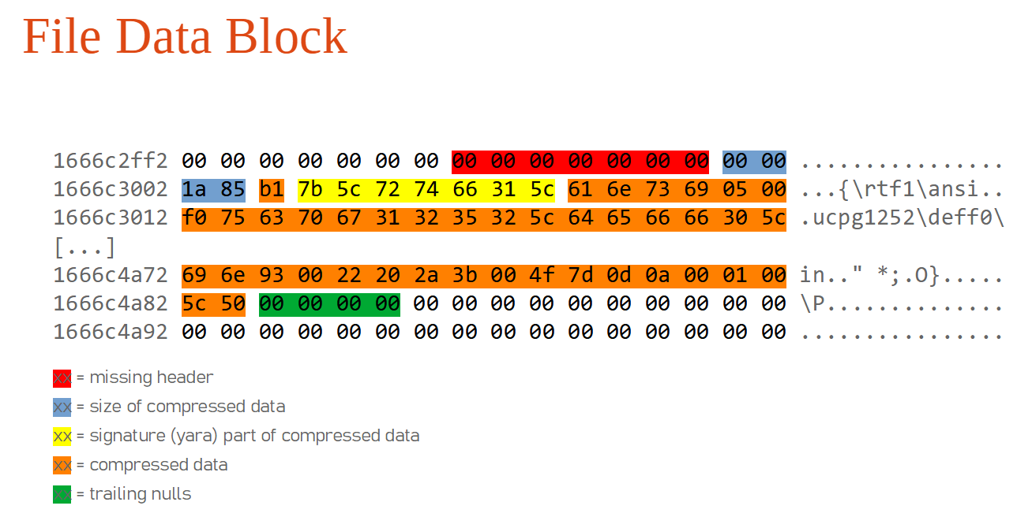

Slide 11
Header
LZ4 header is missing before the file data block so let’s construct minimal header using RTF specification.
LZ4_Header
{
DWORD MagicNb Magic Number
BYTE FLG various properties like version, block checksum etc.
BYTE BD block maximum size
BYTE HC checksum, can be calculated using xxhash on FLG, BD
}

Slide 12
Header.(dword)MagicNb
MagicNb = 0x04 0x22 0x4D 0x18

Slide 13
Header.(byte)FLG
FLG = 0x40 = 01 0 0 0 0 0 0
01 : version
0 : each block depends on previous ones for decoding
0 : no Block checksum in data blocks
0 : uncompressed size of data not included within the header
0 : no content checksum will be appended after the EoS mark
0 : reserved and set to 0
0 : no DictID

Slide 14
Header.(byte)BD
BD = 0x40 = 0 100 0000
100 = 4 = 64 KB of block maximum size
bits 7 and last 4 bits are reserved thus set to 0

Slide 15
Header.(byte)HC
The following python code will generate the HC descriptor checksum :
import xxhash
FLG = 0x40
BD = 0x40
payload = chr(FLG) + chr(BD)
out = xxhash.xxh32(payload, seed=0).intdigest()
out = hex((out>>8) & 0xFF)
print out
HC = 0xC0

Slide 16
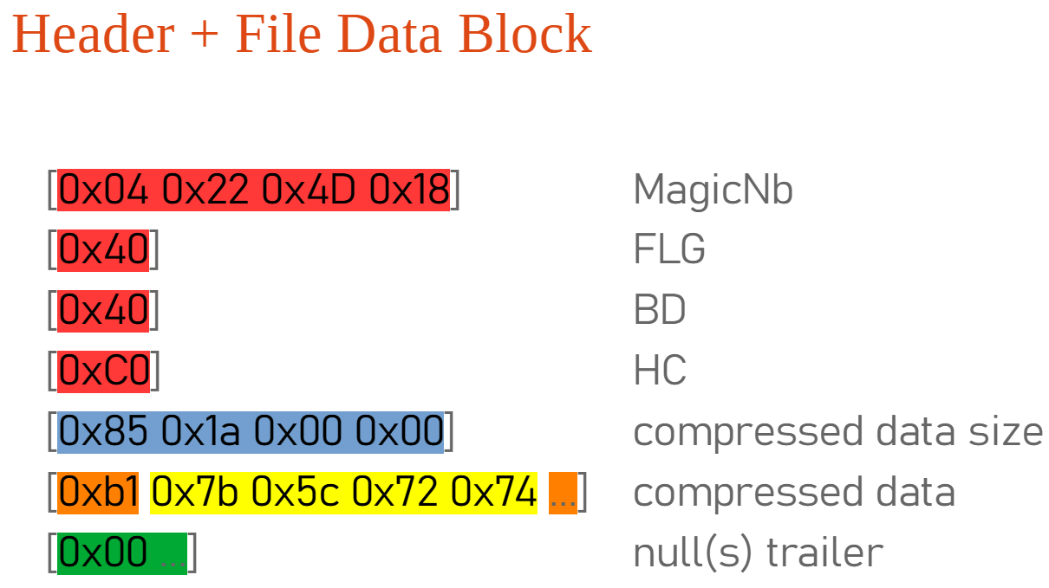

Slide 17
The Automation
python script
scan the image for files using signature
if found then prepend minimal LZ4 header
try to decompress (header + file data block)
if success then write file out

Slide 18
References
Original paper and scripts :
https://github.com/nitsa/zfs

Slide 19
Thank you !

